Slide 1

IMPLEMENTATION OF DEEP LEARNING MODEL FOR AUDIO AND VIDEO ANALYSIS OF HUMAN EMOTIONS
Submitted by:
Abishek Prakash-19BDS0161
Mallikarjun Hatti-19BCE0889
Thukila.C-19BCT0247
Guide Name: Prof Sathya.K
Department: SCOPE

Slide 2
OUTLINE
Introduction
Aim
Objective
Motivation
Analysis and Literature Survey
Working Principle
Demonstration
Result Analysis
Conclusion
Future Works
References

Slide 3
INTRODUCTION
Emotions are abundant in daily life, and there are numerous reasons for determining someone's emotional state, including improved communication and work efficiency.
Product features and design can be determined to be more suitable for users during the product development process by analyzing their emotional states during their user experience. Caregivers in medical care can provide better care to patients if their emotional states in various situations are known.
Deep learning-based audio-visual emotion recognition models such as CNN, GRU and LSTM have demonstrated state-of-the-art performance in recent years.

Slide 4
INTRODUCTION(Contd...)
Emotion recognition is a critical interdisciplinary research topic in a variety of fields, including psychology, neuroscience, and artificial intelligence. Many emotion classification studies use deep learning methods in conjunction with cutting-edge statistics to improve emotion detection accuracy and attempt to integrate multiple modalities for better accuracy.
Human emotions are typically composed of speech and facial expressions. It is a recent area of study that gives machines the capacity to comprehend and perceive human emotions. Machines must be able to comprehend these feelings and react to them sympathetically.

Slide 5
AIM
The project's aim is to assess how well various emotion recognition methods function when there is additional noise and shift in the dataset. The goal of the research is to find the most reliable and efficient model for emotion recognition in noisy and shifting data as well as approaches to increase the model's effectiveness.
The project would include choosing and putting different emotion recognition models, including decision trees, KNN, LSTM, GRU, MLPC, and CNN, into practice. To imitate real-world circumstances, the models would be trained and tested on a dataset that has added noise and shift.
Overall, the aim of the project is to identify the most effective and efficient model for emotion detection in noisy and shifted data, which would be useful in real-world applications where data is often corrupted or distorted.

Slide 6
OBJECTIVE
This project’s objective is to examine the performance of various emotion recognition algorithms in noisy and shifting environments in order to determine which model is the most reliable and accurate under these conditions.
Under these circumstances, the purpose of an emotion detection system using several models would be to appropriately categorize emotions despite the additional noise and shift in the data.

Slide 7
OBJECTIVE(CONTD…)
Identifying the most reliable and efficient model for emotion recognition in shifting and noisy environments is the key point to an emotion detection system. We can discover the best method for emotion recognition in noisy and shifting environments by evaluating the performance of various models, highlighting the advantages and disadvantages of each model.
Overall, the objective of an emotion detection system using multiple models in a theoretical aspect where extra noise and shift is added is to identify the most effective and robust model for emotion detection in noisy and shifted data and explore ways to improve the efficiency and effectiveness of the models.

Slide 8
MOTIVATION
The motivation behind our project is to create methods for automatic emotion recognition that are more precise and effective. In disciplines including psychology, neurology, human-computer interaction, and affective computing, among others, emotion recognition is a crucial task.
Emotion recognition has traditionally been done manually by trained specialists using subjective judgments, which can take a lot of time, money, and be biased. Deep learning algorithms have made it feasible to discern emotional states with high accuracy and in real time by automatically analyzing audio and video data.
Automatic emotion recognition can be used in human-computer interaction to enhance the user experience by customizing the interface to the user's emotional state. It can also be utilized in marketing research to examine customer emotional responses to adverts, resulting in more successful advertising campaigns.

Slide 9
ANALYSIS AND LITERATURE SURVEY
No. | YEAR | AUTHOR | TITLE | ANALYSIS
1 | 2015 | Ko, Kwang-Eun and Sim, Kwee-Bo | Development of a Facial Emotion Recognition Method based on combining AAM with DBN | proposed a facial emotion recognition method combining Active Appearance Models (AAM) with Deep Belief Networks (DBN), achieving high accuracy on standard datasets.
2 | 2016 | Wan Ding , Mingyu Xu , DongyanHuang , Weisi Lin ,Minghui Dong3, Xinguo Yu, Haizhou Li. | Audio and face video emotion recognition in the wild using deep neural networks and small datasets | When the dataset is small it works efficiently. It won’t give better accuracy when large datasets trained . It depends on the dataset what we used. Accuracy – 53.9% . They have used CNN , LSTM , Transfer Learning.
3 | 2017 | Agnieszka Landowska, Grzegorz Brodny and Michal R. Wrobel | Limitations of Emotion Recognition from Facial Expressions | identified challenges in detecting emotions from facial expressions due to variations in the same emotion expressed by different individuals, individual differences in facial anatomy, and the lack of standardized datasets.
4 | 2017 | A. Fathallah, L. Abdi and A. Douik | Facial Expression Recognition via Deep Learning | They have used CAFFE – UBUNTU 14.04 versiorn , GTGPU- 2GB memory . can’t use the multiple hidden layers for emotion recognition. Accuracy – 71.4%
5 | 2018 | Jianfeng Zhao , Xia Mao , Lijiang Chen | Speech Emotion Recognition using deep 1D & 2D CNN LSTM networks | proposed a deep learning-based approach for emotion recognition from speech, achieving high accuracy on standard datasets. Speaker dependent 89.16 Independent 52.14

Slide 10
ANALYSIS AND LITERATURE SURVEY (CONTD…)
No. | YEAR | AUTHOR | TITLE | ANALYSIS
6 | 2018 | L. Santamaria-Granados, M. Munoz-Organero, G. Ramirez-González | Using Deep Convolutional Neural Network for Emotion Detection on a Physiological Signals Dataset | More number of instances gives more accuracy and efficient . less number of instances of a dataset gives low accuracy . 58% and 71%
7 | 2018 | W. Lim, D. Jang and T. Lee | Speech Emotion Recognition using Convolutional and Recurrent Neural Networks | It’s hard to insert the text features into SVM. When the Emotion labels not stable then SER system won’t work properly. It leads to give accuracy low. Accuracy - 85%
8 | 2019 | D Y Liliana | Emotion recognition from facial expression using deep learning | used deep learning techniques for facial expression recognition and achieved high accuracy on standard datasets, but noted that the models are sensitive to variations in pose and lighting conditions.
9 | 2019 | R. Santhoshkumar , M. Kalaiselvi Geetha | Deep learning approach for emotion recognition from human body movements with feed forward Deep convolution neural networks | This work 95.4%. proposed a deep learning-based approach for body movement-based emotion recognition, achieving high accuracy on standard datasets.%.
10 | 2019 | MohammadMehedi Hassan , Md. Golam Rabiul Alam , Md.Zia Uddin , Shamsul Huda , Ahmad Almogren | Human emotion recognition using deep belief network architecture | proposed a deep learning-based approach for emotion recognition from physiological signals, achieving high accuracy on standard datasets.

Slide 11
ANALYSIS AND LITERATURE SURVEY (CONTD…)
S No. | YEAR | AUTHOR | TITLE | ANALYSIS
11 | 2019 | Ruhul Amin Khalil, Edward Jones Mohammad ,Inayatullah Babar, Thamer Alhussain. | Speech Emotion Recognition Using Deep Learning Techniques | If the data’s were varying then the efficiency can be low. Accuracy 92%
12 | 2019 | Wenbin Zhou, Justin Cheng, Xingyu Lei, Bedrich Benes, and Nicoletta Adamo | Deep Learning Based Emotion Recognition from Real-Time Videos | The webcam resolution should be 1920 X 1080. It’s failed to detect the expected emotion. Didn’t find the way to give the desired emotional state . Overall Accuracy - 60%
13 | 2020 | L. B. Krithika & G. G. Lakshmi Priya | Graph based feature extraction and hybrid classification approach for facial expression recognition. | used graph theory for feature extraction and hybrid classification techniques to improve facial expression recognition, achieving better performance than traditional feature extraction methods.
14 | 2020 | Ninad Mehendale | Facial emotion recognition using convolutional neural networks (FERC) | proposed a deep learning-based approach for facial expression recognition, achieving high accuracy on standard datasets. maximum accuracy up to 99.3%
15 | 2020 | Garima Verma & Hemraj Verma | Hybrid-Deep Learning Model for Emotion Recognition Using Facial Expressions | proposed a hybrid-deep learning model for facial expression recognition, combining the strengths of both deep learning and traditional machine learning techniques, achieving high accuracy on standard datasets.

Slide 12
ANALYSIS AND LITERATURE SURVEY(CONTD…)
S No. | YEAR | AUTHOR | TITLE | ANALYSIS
16 | 2020 | Saibal Manna, Sushil Ghildiyal, Kishankumar Bhimani. | Face Recognition from Video using Deep Learning | This model can recognize the side face and blurred image also , still it can give the better accuracy . CNN, FaceNet - 90%
17 | 2021 | Theresa Küntzler , T Tim A Höfling , Georg W Alpers . | Automatic Facial Expression Recognition in Standardized and NonStandardized Emotional Expressions | deep learning-based approach to improve facial expression recognition in both standardized and non-standardized emotional expressions, but performance of the model still depends on the quality of the input images. Accuracy – 97%.
18 | 2021 | Shervin Minaee ,Mehdi Minaei andAmirali Abdolrashidi | Deep- Emotion: Facial Expression Recognition using Attentional Convolutiona l Networks. | presented a facial expression recognition system using attentional CNNs, which outperformed several state-of-the-art methods on standard datasets.92.8%
19 | 2021 | M. Kalpana Chowdary, Tu N. Nguyen & D. Jude Hemanth | Deep learningbased facial emotion recognition for human–computer interaction applications | proposed a deep learning-based approach for facial expression recognition, specifically for human-computer interaction applications.Accuracy94.2%
20 | 2021 | Sharmeen M.Saleem Abdullah , Siddeeq Y. Ameen,Mohammed A. M. Sadeeq, Subhi Zeebaree | Multimodal Emotion Recognition using Deep Learning | Efficiency of the results will be high when we using only one algorithm. In multi model , results will be low if we propose a new approaches or new algorithm to the datasets already trained

Slide 13
WORKING PRINCIPLE
For audio emotion detection:
Video data undergoes frame extraction and scaling.
Audio signals are preprocessed using LSTM to transform them into spectrograms.
Data augmentation techniques add extra noise and shift to the dataset for exploratory data analysis (EDA).
CNN is used for video, and LSTM is used for audio to extract features.
Emotion detection system employs various models: decision trees, KNN, MLP classifiers, GRU, LSTM, and CNN. Models are trained and evaluated using performance measures.

Slide 14
WORKING PRINCIPLE(CONTD…)
For video emotion detection:
Frames from videos are pre-processed.
CNN is used to extract features.
Model is trained, assessed, and used to detect emotions.
Temporal analysis and aggregation of predicted emotions provide a comprehensive understanding of the emotional trajectory throughout the video.
System can be continuously improved by upgrading and enhancing the methodology based on new methods and user input.

Slide 15
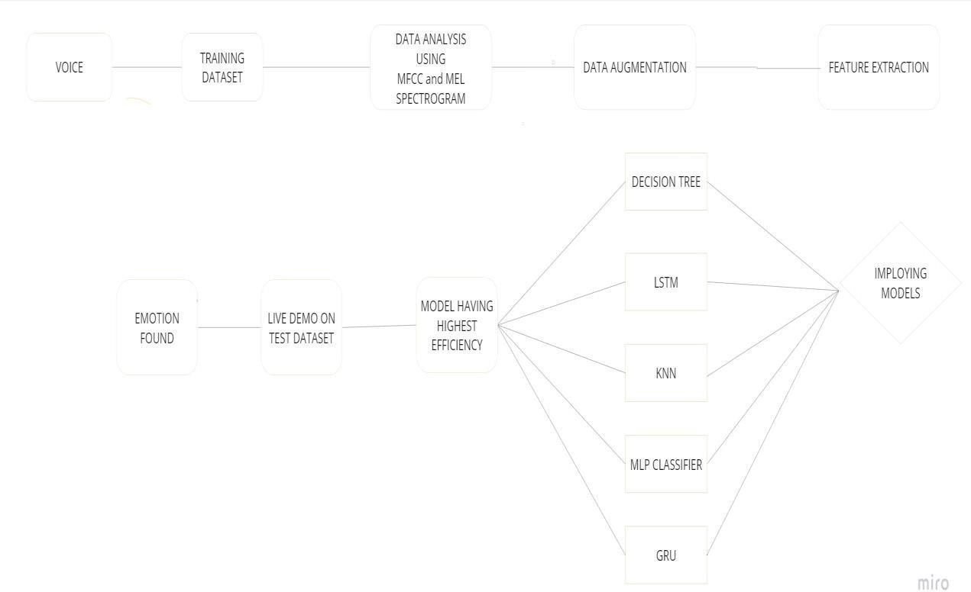
SYSTEM ARCHITECTURE
For audio:

Slide 16
SYSTEM ARCHITECTURE(CONTD…)
For video:

Slide 17
Demonstration
For Audio:
Importing the necessary libraries:
Setting the dataset path:
Defining emotions in the dataset and printing their count:
Visualizing emotions and their count using a bar graph:
Creating a log mel spectrogram for specific emotions:
Performing data augmentation techniques such as noise injection and time shifting to create augmented data samples.
Extracting features from audio data:
Preprocessing the data by splitting it into training and test sets and using LSTM for training and testing.

Slide 18
Demonstration(CONTD…)
Evaluating various models (Decision Tree, KNN, MLP Classifier, GRU, LSTM, CNN) and selecting the most efficient one (e.g., CNN with 75.55% accuracy).
Saving the trained model
Loading the trained model and making predictions on new input
Resampling the audio to the desired sample rate
Extracting MFCC features from the resampled audio
Preprocessing the features before making predictions
Making predictions using the trained model
Displaying the predicted emotion

Slide 19
Demonstration
For Video:
Collect a dataset of labeled facial images representing different emotions.
Preprocess the dataset by resizing, converting, normalizing, and augmenting the images.
Split the dataset into training, validation, and testing sets.
Design a CNN architecture tailored for emotion recognition.
Train the CNN model using the training dataset.
Fine-tune the hyperparameters using the validation set.
Evaluate the model's performance using the testing dataset.
Deploy the trained model for real-time emotion recognition.

Slide 20
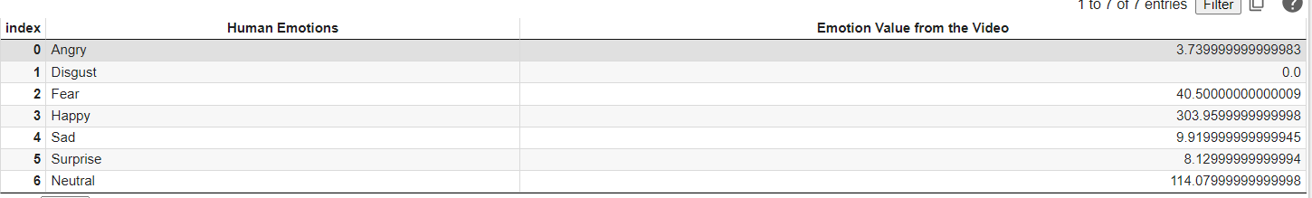
RESULT ANALYSIS
For video analysis:
Average of emotions from input video:

Slide 21
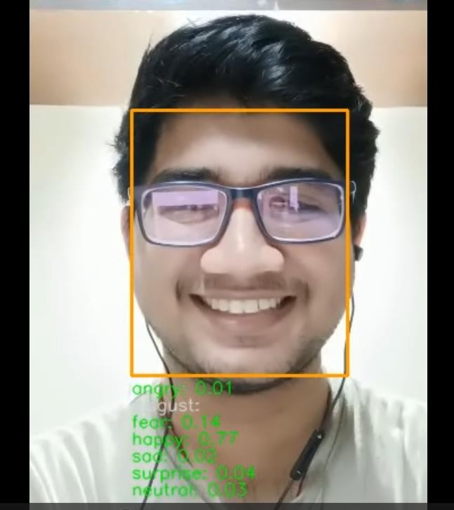
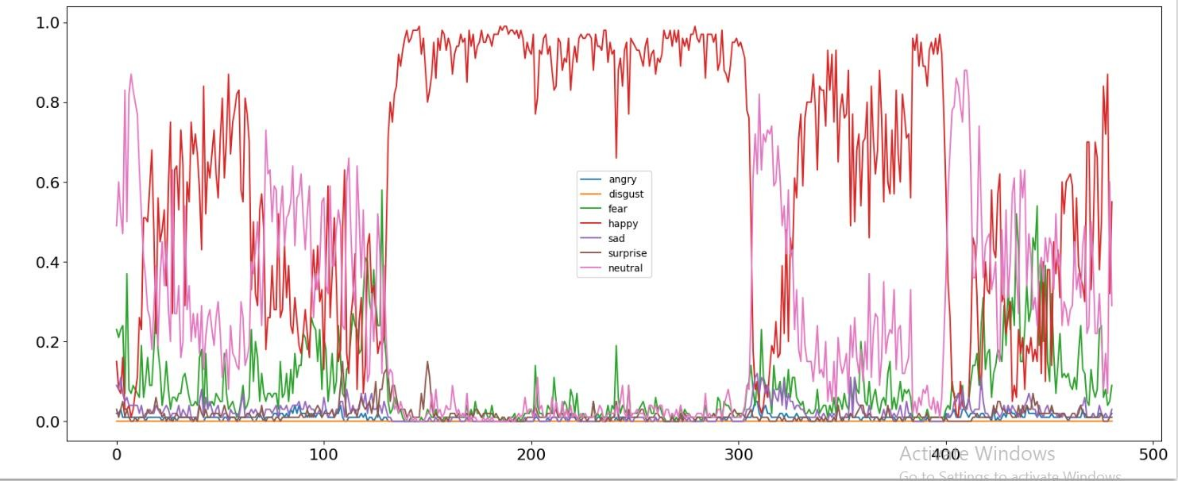
RESULT ANALYSIS(contd…)
Output result: Graph of emotions:

Slide 22
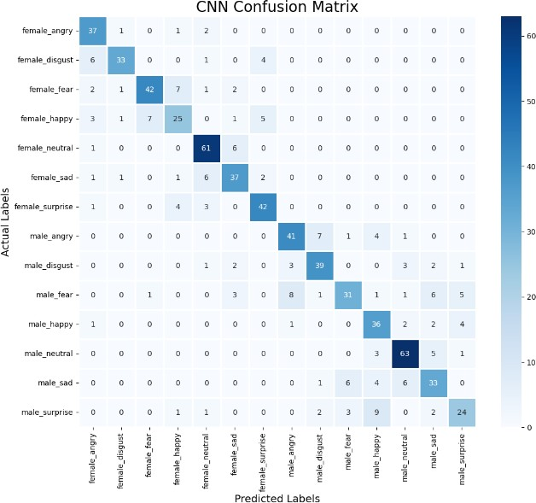
RESULT ANALYSIS(CONTINUED…)
For Audio
CNN Confusion Matrix Using CNN Model

Slide 23
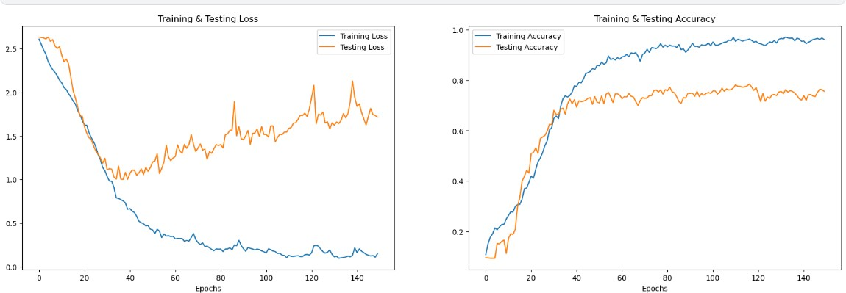

RESULT ANALYSIS(CONTINUED…)
Loss Accuracy Plot using CNN:
Input file matrix:

Slide 24
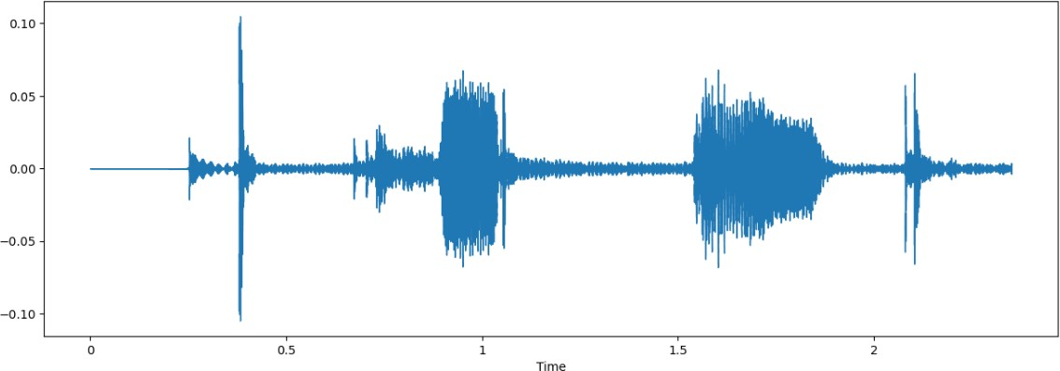
RESULT ANALYSIS(CONTINUED…)
Input audio file wave display:
Final Output:

Slide 25
CONCLUSION
In conclusion, the emotion detection systems using various classifiers (decision tree, KNN, MLP classifier, GRU, LSTM, and CNN) have shown promise in accurately detecting emotions from speech and video data. The inclusion of additional noise and shift, along with LSTM for data pre-processing, has improved generalization.
The CNN-based approach for video analysis has proven effective in recognizing emotions by extracting spatial features from video frames.
These systems have potential applications in healthcare, education, entertainment, video surveillance, market research, and multimedia content analysis. Continued research and development are necessary to enhance their performance and optimize real-world applications.

Slide 26
FUTURE WORKS
Transfer Learning: Utilize transfer learning methods to transfer knowledge from pre-trained models, reducing the need for extensive labeled data.
Attention Mechanisms: Incorporate attention mechanisms to assign higher importance to relevant areas of the input, improving emotion identification accuracy.
Contextual Analysis: Consider the context, including verbal and nonverbal cues, as well as social and cultural background, to enhance the precision of emotion recognition systems.
Meta-Learning: Apply meta-learning techniques to enable rapid adaptation to new situations, progressively improving the accuracy of the system.
Self-Supervised Learning: Use self-supervised learning techniques to pre-train emotion detection models on unlabeled data when labeled data is scarce, enhancing their performance.

Slide 27
REFERENCES
[1] Ouellet, Sébastien. "Real-time emotion recognition for gaming using deep convolutional network features." arXiv preprint arXiv:1408.3750 (2014).
[2] Pranav, E., Suraj Kamal, C. Satheesh Chandran, and M. H. Supriya. "Facial emotion recognition using deep convolutional neural network." In 2020 6th International conference on advanced computing and Communication Systems (ICACCS), pp. 317-320. IEEE, 2020.
[3] Abdullah, Sharmeen M. Saleem Abdullah, Siddeeq Y. Ameen Ameen, Mohammed AM Sadeeq, and Subhi Zeebaree. "Multimodal emotion recognition using deep learning." Journal of Applied Science and Technology Trends 2, no. 02 (2021): 52-58.
[4] Khanzada, Amil, Charles Bai, and Ferhat TurkerCelepcikay. "Facial expression recognition with deep learning." arXiv preprint arXiv:2004.11823 (2020).
[5] Khalil, Ruhul Amin, Edward Jones, Mohammad Inayatullah Babar, Tariqullah Jan, Mohammad Haseeb Zafar, and ThamerAlhussain. "Speech emotion recognition using deep learning techniques: A review." IEEE Access 7 (2019): 117327-117345.

Slide 28
REFERENCES(CONTD…)
[6] El Mettiti, Abderrahmane, Mohammed Oumsis, AbdellahChehri, and Rachid Saadane. "Real-Time Emotion Recognition Using Deep Learning Algorithms." In 2022 IEEE 96th Vehicular Technology Conference (VTC2022-Fall), pp. 1-5. IEEE, 2022.
[7] Li, Junnan, and Edmund Y. Lam. "Facial expression recognition using deep neural networks." In 2015 IEEE International Conference on Imaging Systems and Techniques (IST), pp. 1-6. IEEE, 2015.
[8] Sinha, Avigyan, and R. P. Aneesh. "Real time facial emotion recognition using deep learning." International Journal of Innovations and Implementations in Engineering 1 (2019).
[9] Jermsittiparsert, Kittisak, Abdurrahman Abdurrahman, ParinyaSiriattakul, Ludmila A. Sundeeva, Wahidah Hashim, Robbi Rahim, and AndinoMaseleno. "Pattern recognition and features selection for speech emotion recognition model using deep learning." International Journal of Speech Technology 23 (2020): 799-806.
[10] Wu, Ching-Da, and Li-Heng Chen. "Facial emotion recognition using deep learning." arXiv preprint arXiv:1910.11113 (2019).

Slide 29
REFERENCES(CONTD…)
[11] Jaymon, Noel, Sushma Nagdeote, Aayush Yadav, and Ryan Rodrigues. "Real time emotion detection using deep learning." In 2021 International conference on advances in electrical, computing, communication and sustainable technologies (ICAECT), pp. 1-7. IEEE, 2021.
[12] Sang, Dinh Viet, and Nguyen Van Dat. "Facial expression recognition using deep convolutional neural networks." In 2017 9th International Conference on Knowledge and Systems Engineering (KSE), pp. 130-135. IEEE, 2017.
[13] Song, Inchul, Hyun-Jun Kim, and Paul Barom Jeon. "Deep learning for real-time robust facial expression recognition on a smartphone." In 2014 IEEE International Conference on Consumer Electronics (ICCE), pp. 564-567. IEEE, 2014.
[14] Fathallah, Abir, Lotfi Abdi, and Ali Douik. "Facial expression recognition via deep learning." In 2017 IEEE/ACS 14th International Conference on Computer Systems and Applications (AICCSA), pp. 745-750. IEEE, 2017.
[15] Zhang, Qiang, Xianxiang Chen, Qingyuan Zhan, Ting Yang, and Shanhong Xia. "Respiration-based emotion recognition with deep learning." Computers in Industry 92 (2017): 84-90.

Slide 30
THANK YOU

